Slide 1
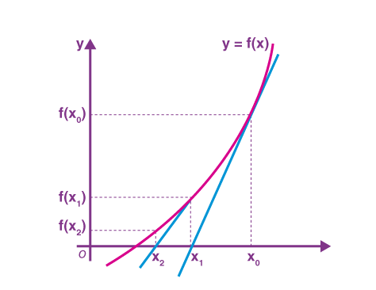
When Root-Finding Methods Fail: Newton-Raphson & False Position
Exploring the limitations and failure modes of common root-finding algorithms.

Slide 2
Team Epsilon (ϵ)
Md Hridoy Nur – 2024000000322
Tushar Imran Riyad – 2024000000218
MD Rifat Mojumder Rownak – 2024000000319
Mst. Jannatun Ferdous Ety – 2024000000079
S.M. Jannat Kamal Sathi - 2024000000127
Nur-E-Yesrif Samia - 2024000000325

Slide 3



Why Study Failures?
Avoid Computation Waste
Popularity ≠ Perfection
Identify Specific Weaknesses
Understanding failure modes helps prevent wasted computational resources and incorrect results.
Newton-Raphson and False Position are widely used but have inherent pitfalls.
We'll explore scenarios where these methods struggle or fail to converge effectively.

Slide 4
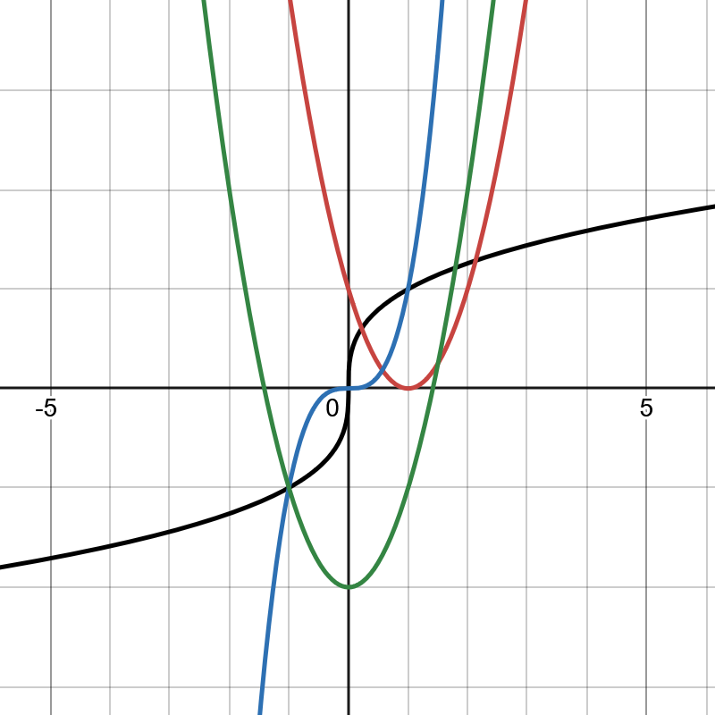
Newton-Raphson Method Recap
The Newton-Raphson method is a powerful iterative technique for finding
successively better approximations to the roots (or zeroes) of a real-valued function.
Quadratic Convergence: Achieves rapid convergence near simple roots if f'(x) $≠$0.
Requirements: Needs both the function f(x) and its derivative f'(x).
Initial Guess: Highly dependent on a good initial guess close to the actual root.

Slide 5
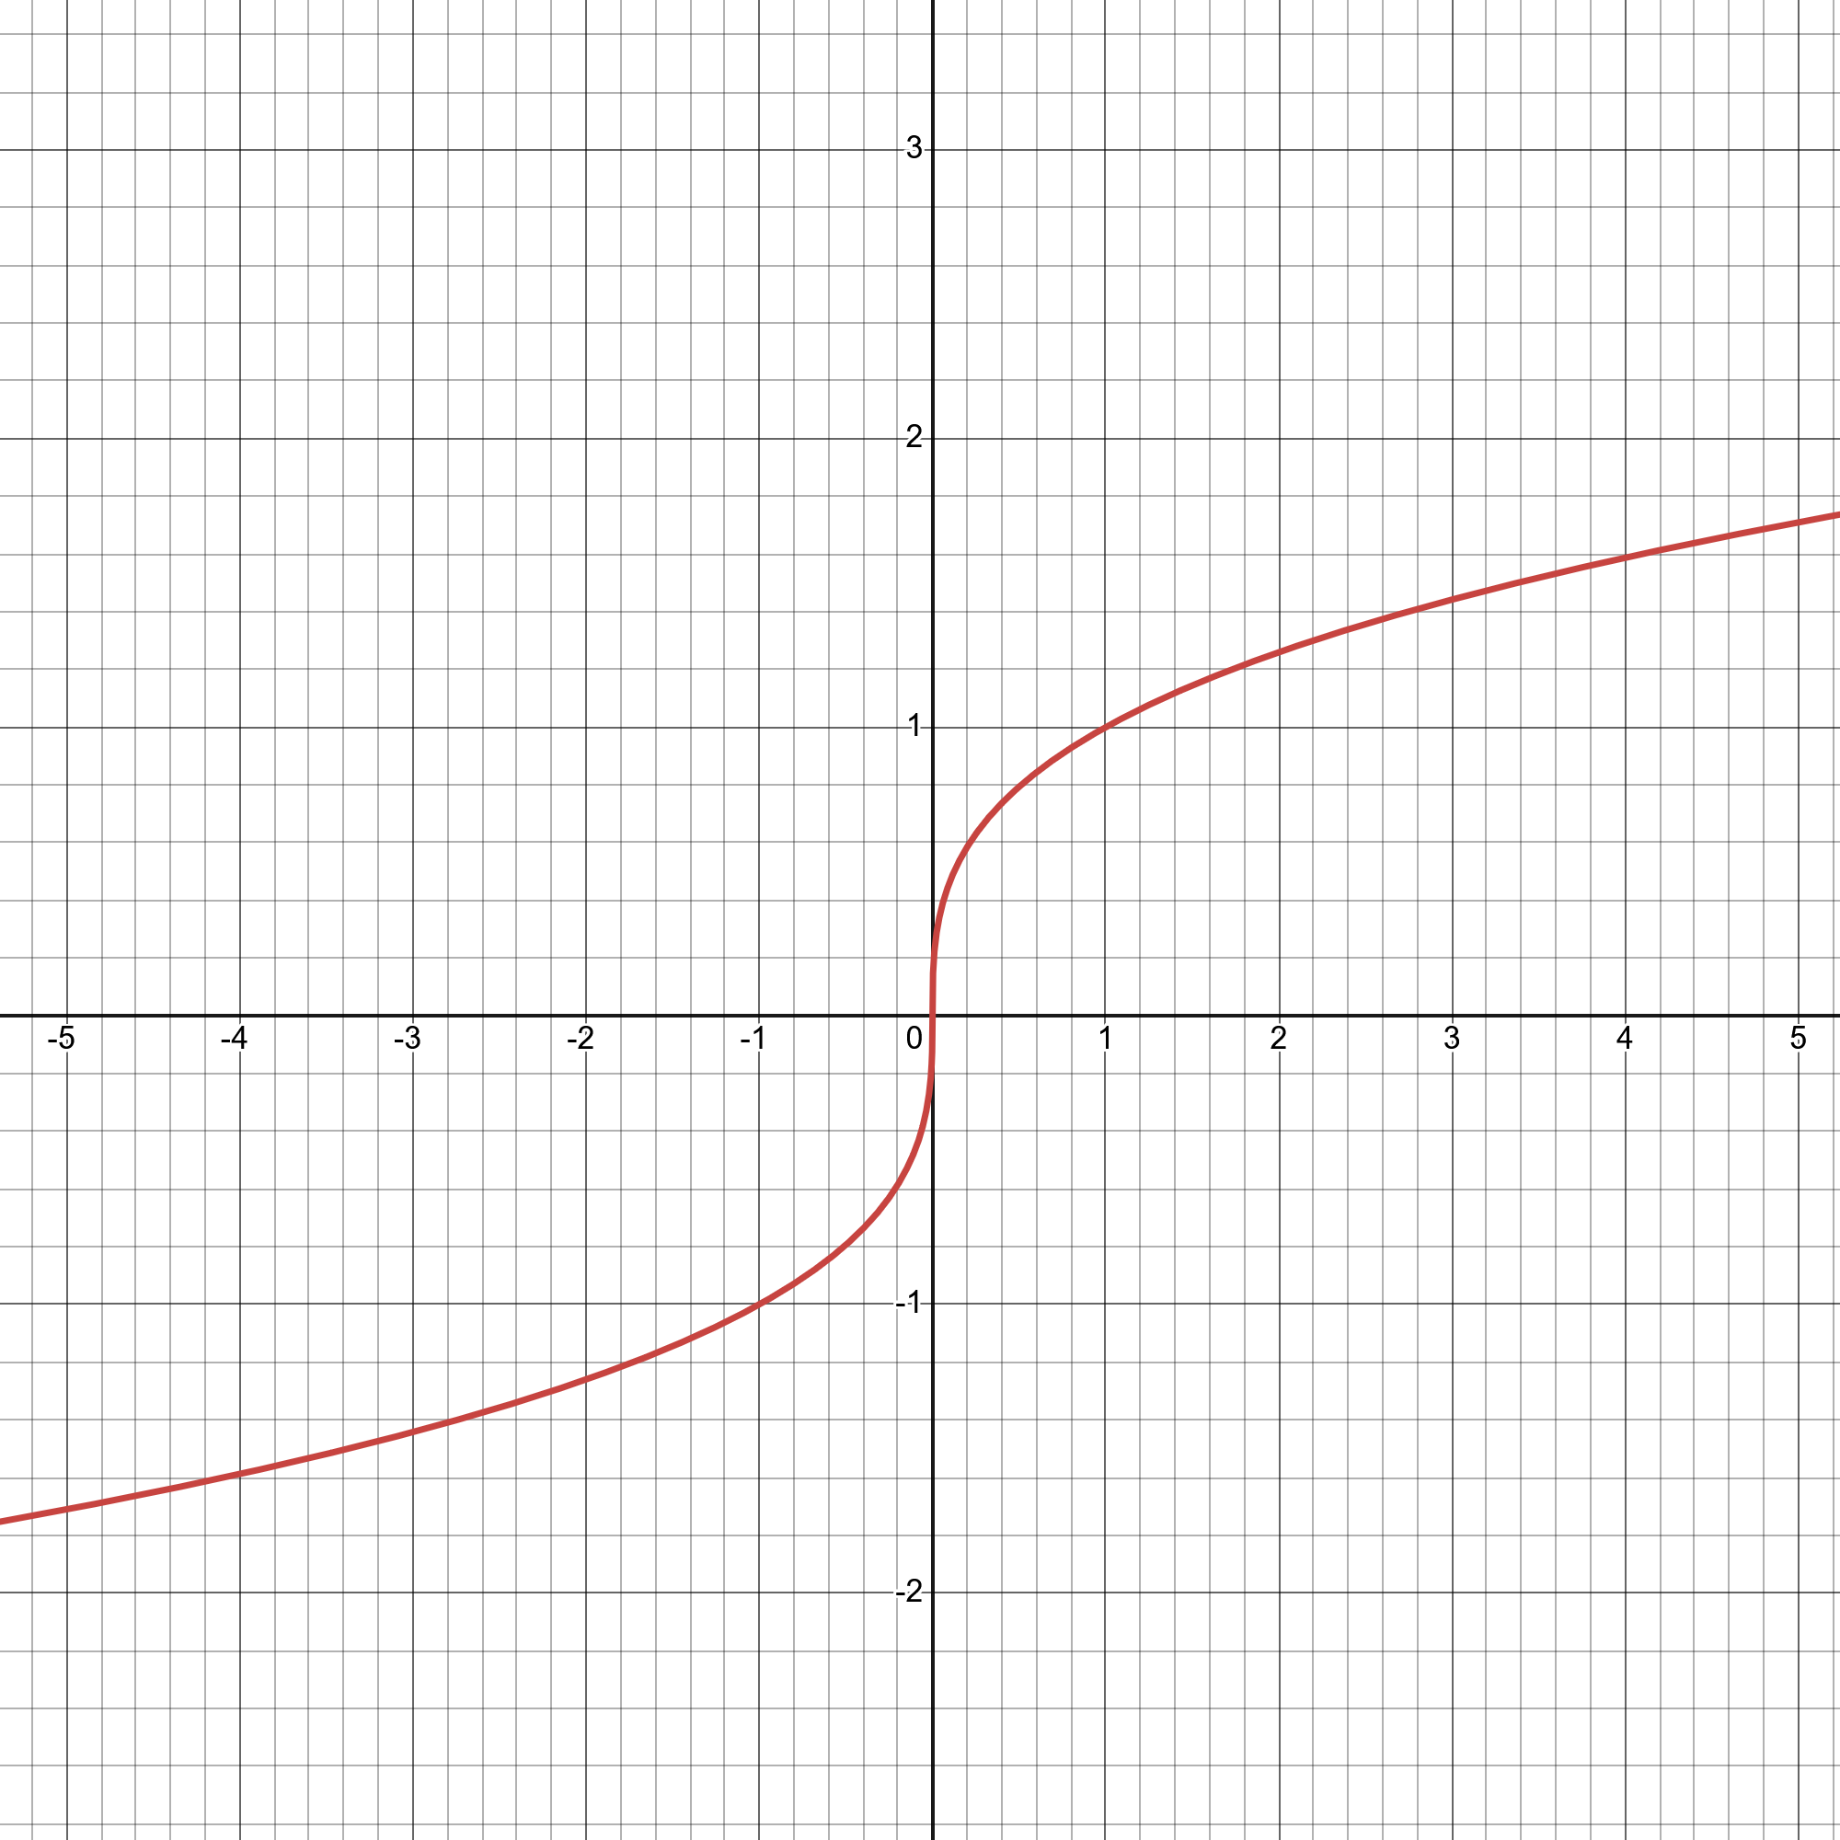

Newton-Raphson Failure #1: Bad Initial Guess
A poorly chosen starting point can lead the method far astray from the desired root.
Example: f(x) = ∛x with an initial guess $x_{0}$ = 0.1.
Problem: The derivative f'(x) becomes very large near the root. This results in the term being small, causing the next iterate to jump significantly away from the root.
Result: Iterations can diverge rapidly or oscillate, failing to converge to any root.

Slide 6
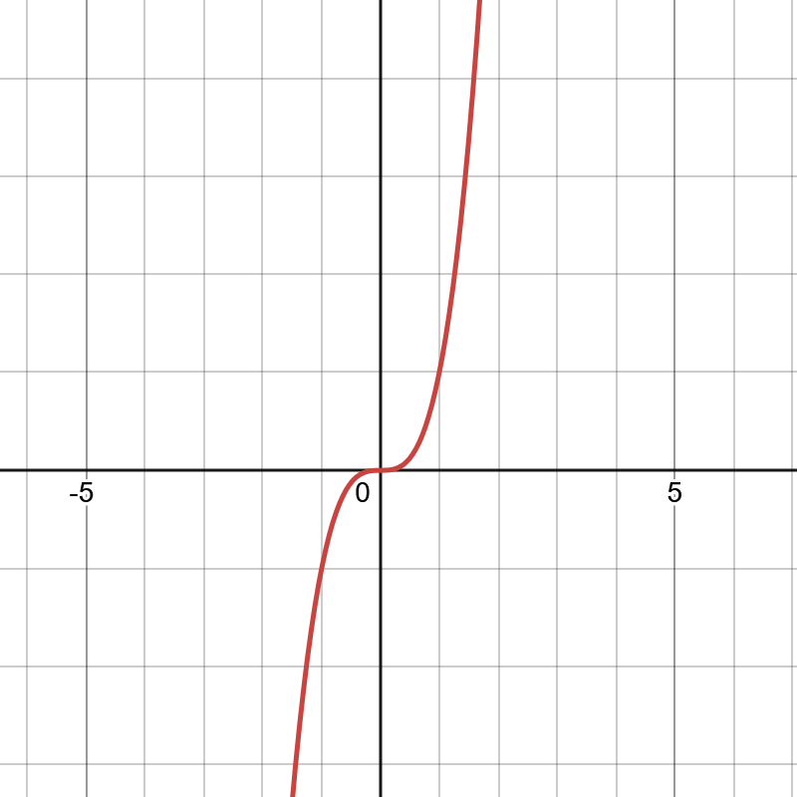


Newton-Raphson Failure #2: Stationary Points
When the derivative is zero or very close to zero, Newton-Raphson encounters significant problems.
Problem: If f'($x_{n}$) = 0, the formula involves division by zero, causing a mathematical breakdown.
Example: f(x) = $x^{3}$ when $x_{0}$ = 0. The derivative at the root x=0 is also zero.
Impact: Even near a stationary point where the derivative is tiny, convergence becomes extremely slow, or the method jumps far away from the root.

Slide 7

Newton-Raphson Failure #3: Multiple Roots
When a function has a root with a multiplicity greater than one (meaning the function and its derivative are both zero at that point), Newton-Raphson's performance degrades.
Slowed Convergence
Example: f(x) = ${(x−1)}^{2}$
Underlying Cause
Instead of quadratic convergence, the method only achieves linear convergence, meaning it approaches the root much more slowly.
Here, x=1 is a root of multiplicity 2. Iterations will crawl towards 1.
The condition for quadratic convergence, f'(root) \neq 0, is violated, as both the function and its derivative are zero at such a root.

Slide 8
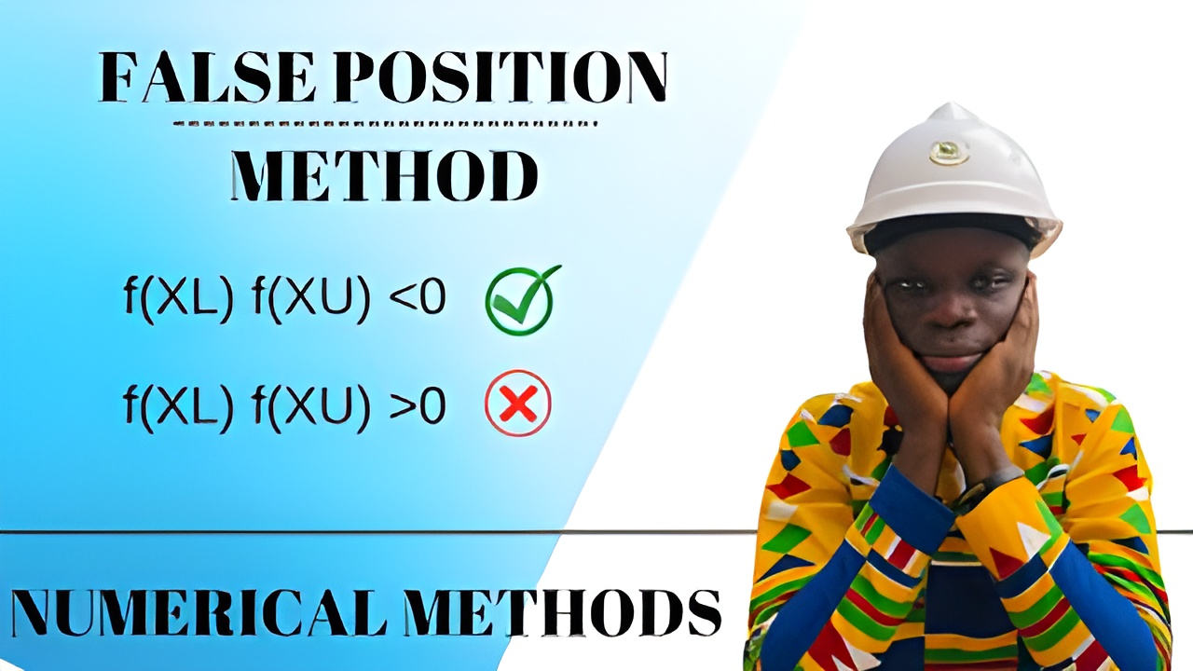
False Position Method Recap
The False Position method (Regula Falsi) is a bracketing method that combines aspects of the bisection method and the secant method.
Bracketing: Requires an interval [a,b] where f(a) and f(b) have opposite signs (i.e., f(a)f(b) < 0). This ensures a root exists within the interval.
Linear Interpolation: Approximates the root by finding where the line connecting (a,f(a)) and (b,f(b)) crosses the x-axis.
Guaranteed Convergence: Unlike Newton-Raphson, it is guaranteed to converge to a root if one exists within the initial bracket.
Potential Drawback: While always convergent, it can sometimes be very slow.

Slide 9
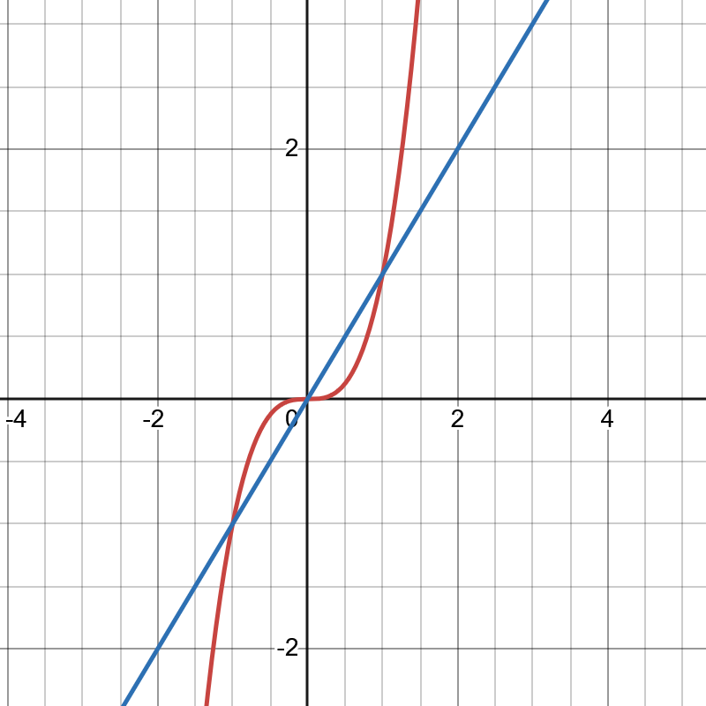

False Position Failure: Slow Convergence / Stagnation
The False Position method can exhibit very slow convergence, often due to one endpoint of the bracketing interval becoming "stuck."
Problem: If the function is concave or convex within the interval, and one of the endpoints has a function value very close to zero while the root is near the other endpoint, the method might repeatedly choose the same "stuck" endpoint.
Example: f(x) = $x^{3}$ on the interval [-1,1]. If the root is x=0, one side of the bracket might barely move.
Impact: The interval shrinks predominantly from one side, leading to very slow progress toward the root, or effective stagnation.

Slide 10
Why These Failures Happen: Summary
Newton-Raphson's Derivative Dependency: Failure when f'($x_{n}$) is zero or near-zero, leading to division by zero or huge jumps.
Bad Initial Guesses: Can cause Newton-Raphson to diverge or oscillate far from the actual root.
Multiple Roots: Significantly slows down Newton-Raphson's convergence from quadratic to linear.
False Position's Stagnation: Occurs when one endpoint of the bracket repeatedly fails to update, due to the function's shape.
Function Behavior: Both methods are sensitive to the local and global behavior of the function, including its derivatives and concavity.

Slide 11
Takeaways & Best Practices
Analyze Function Behavior
Use Bracketing for Guesses
Address Multiple Roots
Always examine the function's shape and derivatives before applying Newton-Raphson.
Employ methods like Bisection or False Position to find reliable initial guesses for Newton-Raphson.
Consider modified Newton methods or specialized algorithms for roots with multiplicity.
>
>
Monitor & Adapt
Enhance Reliability
Continuously monitor iterations for divergence or stagnation. Be ready to switch methods if needed.
A deep understanding of failure modes is crucial for saving time and improving numerical computation reliability.
>
>

Slide 12


Slide 13



